Slide 1
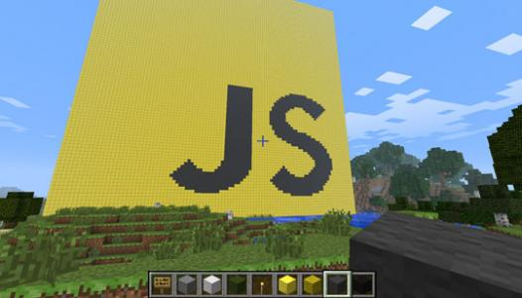
Writing Plugins in Minecraft with JavaScript
More Advanced Plugins

Slide 2
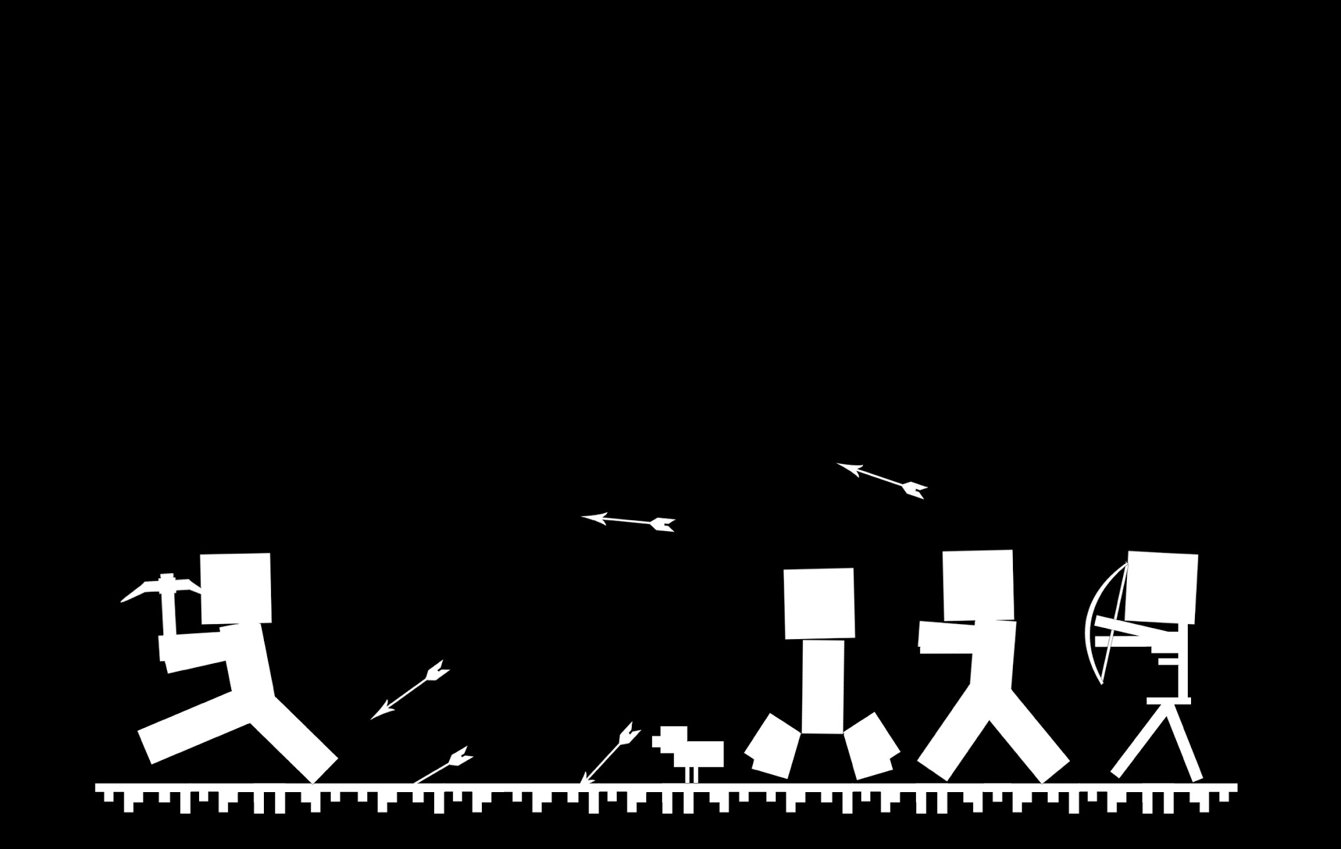
Fireball Sword

Slide 3

Goals For Our Plugin
Add a new file called plugins/fireballSword.js
Todo:
Create a sword that shoots fireballs when swung
Fireballs should only destroy mobs (not blocks or yourself)
Special recipe to craft the sword
Only shoot fireballs at full health

Slide 4
var items = require('items');
function onArmSwing(event) {
var player = event.player;
var itemInHand = player.getItemHeld();
If ( isFireballSword( itemInHand ) ) {
player.chat('it works!');
}
}
function isFireballSword(item) {
if ( item && item.getType() ==
items.diamondSword() ) {
return true;
}
return false;
}
events.playerArmSwing(onArmSwing);
Arm Swing Event Hook

Slide 5
var items = require('items');
var entities = require('entities');
var cm = Packages.net.canarymod;
var factory = cm.Canary.factory();
var entityFactory = factory.entityFactory;
function shootFireball(player) {
var entityType = entities.largefireball();
var loc = player.location;
var fireball = entityFactory.newEntity(entityType, loc);
fireball.spawn();
}
function onArmSwing(event) {
…
player.chat('it works!');
shootFireball(player);
…
}
Spawning the Fireball

Slide 6
function cartesianCoords( player ) {
var pitch = ( player.getPitch() + 90 ) * Math.PI / 180;
var rot = ( player.getRotation() + 90 ) * Math.PI / 180;
var x = Math.sin(pitch) * Math.cos(rot);
var y = Math.cos(pitch);
var z = Math.sin(pitch) * Math.sin(rot);
return [x, y, z];
}
function shootFireball(player) {
...
fireball.spawn();
fling( player, fireball, 3 );
}
function fling( player, entity, factor ) {
var coord = cartesianCoords(player);
var x = coord[0]; var y = coord[1]; var z = coord[2];
entity.moveEntity(x * factor, y + 0.5, z * factor);
}
Flinging the Fireball
Notes:
Good explanation of math here:
https://bukkit.org/threads/tutorial-how-to-calculate-vectors.138849/

Slide 7
...
var entityFactory = factory.entityFactory;
var cmLocation = cm.api.world.position.Location;
function shootFireball(player) {
var entityType = entities.largefireball();
var loc = player.location;
var loc = getBufferInFrontOfPlayer(player);
…
}
function getBufferInFrontOfPlayer(player) {
var coord = cartesianCoords(player);
var distance = 2;
var dx = coord[0] * distance;
var dy = coord[1] * distance;
var dz = coord[2] * distance;
var loc = player.location;
var x = loc.getX() + dx;
var y = loc.getY() + dy + 0.5;
var z = loc.getZ() + dz;
return new cmLocation(x, y, z);
}
Get the Block in Front of the Player

Slide 8
function shootFireball(player) {
...
fireball.spawn();
/* prevent fireball from destroying blocks */
fireball.setPower(0);
fling( player, fireball, 3 );
}
Don’t Destroy Blocks

Slide 9
var cmDiamondSword = items.diamondSword(1);
var itemFactory = factory.itemFactory;
var cmEnchantment = cm.api.inventory.Enchantment.Type;
var cmLuck = itemFactory.newEnchantment(cmEnchantment.LuckOfTheSea,3);
cmDiamondSword.addEnchantments( [ cmLuck ] );
var fireballSwordRecipe = new Object();
fireballSwordRecipe.result = cmDiamondSword;
fireballSwordRecipe.shape = [ 'BDB',
'BDB',
'BSB' ];
fireballSwordRecipe.ingredients = {
B: items.blazeRod(1),
D: items.diamond(1),
S: items.stick(1)
};
var recipes = require('recipes');
var recipe = recipes.create(fireballSwordRecipe);
server.addRecipe( recipe );
Special Crafting Recipe

Slide 10
function isFireballSword(item) {
if ( item && item.getType() == items.diamondSword() ) {
var enchantment = item.getEnchantment();
If (enchantment && enchantment.getLevel() == 3 && enchantment.getType() == cmEnchantment.LuckOfTheSea) {
return true;
}
}
return false;
}
Checking for the Recipe

Slide 11
function onArmSwing(event) {
var player = event.player;
var itemInHand = player.getItemHeld();
If ( player.getHealth() == 20 && isFireballSword( itemInHand ) ) {
shootFireball(player);
}
}
Tie to Player Health

Slide 12
function shootFireball(player) {
...
fling( player, fireball, 3 );
var threeSeconds = 3000;
setTimeout(function() { fireball.destroy(); }, threeSeconds);
}
Disposing of Un-exploded fireballs

Slide 13
That’s all!
Now you should have a fully working fireball sword!

